Slide 1


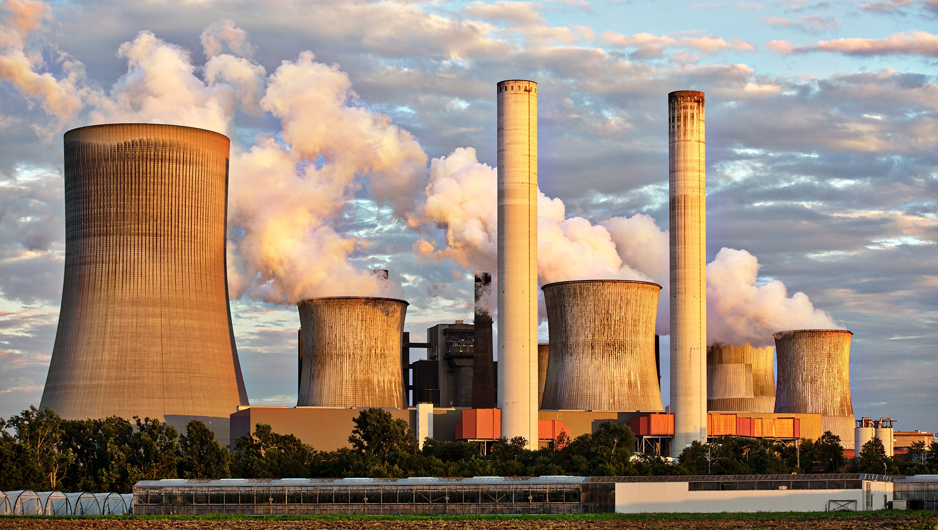
AIR QUALITY ANALYSIS AND PRECTION IN TAMIL NADU
PROJECT REPORT PHASE-1
SUBMITTED BY,
AKASH. SG
REG NO:961721106301

Slide 2
TABLE OF CONTENTS
INTRODUCTION
EXPLORATORY DATA ANALYSIS
AIR QUALITY MEASUREMENT
AIR QUALITY PREDICTION
CONCLUTION

Slide 3
Introduction
Air pollution is one of the greatest environmental risk to health. By reducing air pollution levels, countries can reduce the burden of disease from stroke, heart disease, lung cancer, and both chronic and acute respiratory diseases, including asthma.
Here we are studied about the air quality analysis methods in Tamil Nadu

Slide 4


EXPLORATORY DATA ANALYSIS
Exploratory data analysis is performed on the raw data. The insights gained from the analysis helps to identify the pre- processing tasks that need to be performed to form the dataset for building the air quality prediction model.

Slide 5
AIR QUALITY MEASURMENT
Air quality is measured with the Air Quality Index, or AQI. The AQI works like a thermometer that runs from 0 to 500 degrees. However, instead of showing changes in the temperature, the AQI is a way of showing changes in the amount of pollution in the air.
Air quality is a measure of how clean or polluted the air is. Monitoring air quality is important because polluted air can be bad for our health—and the health of the environment.
Air quality is measured with the Air Quality Index, or AQI. The AQI works sort of like a thermometer that runs from 0 to 500 degrees. However, instead of showing changes in the temperature, the AQI is a way of showing changes in the amount of pollution in the air.

Slide 6
AIR QUALITY PREDICTION
To predict the AQI, MLR and supervised machine learning technique were used. Various quantitative indices were used to assess the performance.
Second, to forecast the AQI in the future, the ARIMA time series model was used. Both models were found to be highly accurate and efficient in forecasting the AQI

Slide 7
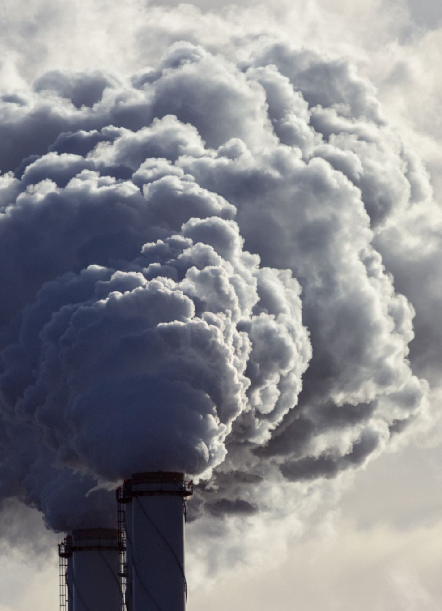
CONCLUSION
In conclusion, ambient air pollution is a health hazard. It is a global challenge, as evidence shows that adverse effects still exist even at relatively low air pollutant concentrations, and so no threshold values for classical air pollutants can be established based on the available data.

Slide 8





SAVE NATURE THANK YOU

